Slide 1
DATABASE MANAGEMENT SYSTEM
Data Models / Chapter 02
Asma Irfan
Department of Computer Science
Bahria University (Karachi Campus)
Asmairfan.bukc@bahria.edu.pk
https://sites.google.com/site/asmairfanbukc

Slide 2
Objectives
2
Data Modeling and Data Models
Importance of Data Models
Building Blocks of Data Model
Business Rules
Evolution of Data Models

Slide 3
Data Modeling and Data Models
3
Data Model
Relatively simple representation of complex real-world data structures (Usually graphical)
A “blueprint” containing all the instructions to build a database that will meet all end-user requirements.
Data Modeling
Process of creating a data model for a determined problem domain
First step in designing a database
An iterative, progressive process, that starts as simple model and goes into much detail as the understanding of the problem domain increases

Slide 4
Importance of Data Models
4
Facilitate interaction among designer, application programmer and the end-user. (communication tool)
Improved understanding of the organization for which the database design is developed.
Without a model, data view will be different for different levels of employees, manager, clerk, president, application programmers and for different departments.
When a good database blueprint is available, differences in view of data by different employees/departments do not matter anymore.

Slide 5
Basic Building Blocks of Data Model
5
Entity
Anything about which data are to be collected and stored (a person, a place, a thing, or an event). Example: CUSTOMER
Each entity occurrence is unique and distinct
Attribute
A characteristic of an entity
Example: customer name, customer phone number, etc.
Relationship
Describes an association among entities
For example, a relationship between customers and agents can be described as “an agent can serve many customers”

Slide 6
Basic Building Blocks of Data Model
(contd.)
6
One-to-many (1:M or 1:N) relationship
PAINTER paints PAINTING
(A painter paints many different paintings)
CUSTOMER generates INVOICE
(each invoice is generated by only one customer)
Many-to-many (M:N or M:M) relationship
EMPLOYEE learns SKILL
(An employee may learn many job skills, each job skill may be learned by many employees)
STUDENT takes CLASS
One-to-one (1:1 ) relationship
EMPLOYEE manages STORE
(each store is managed by single employee, each store manager, who is an employee, manages only a single store)

Slide 7
Basic Building Blocks of Data Model
(contd.)
7
Constraint
A restriction placed on the data
Helps ensure data integrity
Examples:
A student’s GPA must be between 0.00 and 4.00
Each class must have one and only one teacher
An employee’s salary must be between 6,000 and 350,000

Slide 8
Business Rules
8
A brief, precise and unambiguous description of a policy, procedure, or principle within a specific organization. (Note: an organization could be a business, government unit, research
laboratory, university, etc. that stores and uses data to generate information)
Used in defining entities, attributes, relationships and constraints.
Nouns for entities, verbs for relationships
Examples:
A customer may generate many invoices
An invoice is generated by only one customer
A training session cannot be scheduled for fewer than 10 employee or more than 30 employees
Entities: CUSTOMER, INVOICE, EMPLOYEE, TRAINING
Relationships: 1:M between CUSTOMER and INVOICE, M:N between EMPLOYEE and TRAINING
Constraint: No fewer than 10, no more than 30 employees in training

Slide 9
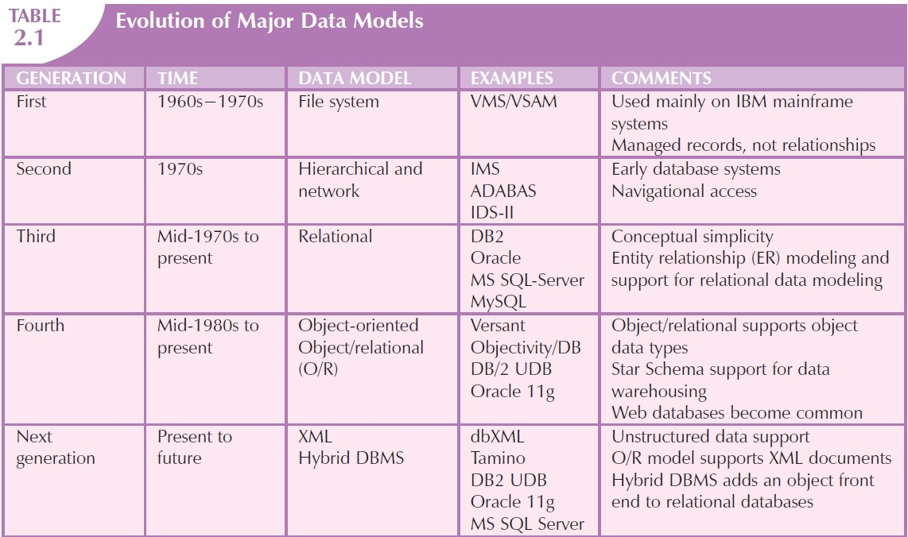
Evolution of Data Models
9

Slide 10















Evolution of Data Models (contd.)
10
Hierarchical Model (1960s)
To manage large amount of data for complex manufacturing projects such as Apollo rocket that landed on the moon in 1969
Logical Structure represented by an upside down tree
Contains levels or segments
(segment = file system’s record type)
1:M relationships
A
Lack of ad hoc query capability
B
C
D
E
F
G
H
C is parent of G and H
G and H are children of C

Slide 11

Evolution of Data Models (contd.)
11
Network Model
To represent complex data relationships more effectively than the hierarchical model
To improve database performance and to impose database standards.
Allowed a record to have more than one parent
Lack of ad hoc query capability
Generally not used today but the definitions of standard database concepts that
A
B
C
emerged with the network model are still used by modern data models.
D
E F G
B and C are parents of F
F is child of both B and C
H

Slide 12
Evolution of Data Models (contd.)
12
Concepts that emerged with the Network Model
Schema: Conceptual organization of the entire database as viewed by the DBA.
Subschema: Defines a portion of the database as seen by the application programs producing desired information from the data within database.
Data Management Language (DML): Defines the environment in which data can be managed and to work with the data in the database.
Data Definition Language (DDL): Enables the DBA to define the schema components.

Slide 13
Evolution of Data Models (contd.)
13
Relational Model
Introduced by E. F. Codd (of IBM) in 1970
Major breakthrough, a database revolution
Based on mathematical concept “relation”
Relation = matrix (table) consisting of tuples (rows) and attributes (columns)
Tables are related through a common attribute (Fig. 2.1)
Relational Database Management Systems (RDBMS)
Used Relational Diagrams (Fig. 2.2)
Introduced Structured Query Language (SQL)

Slide 14
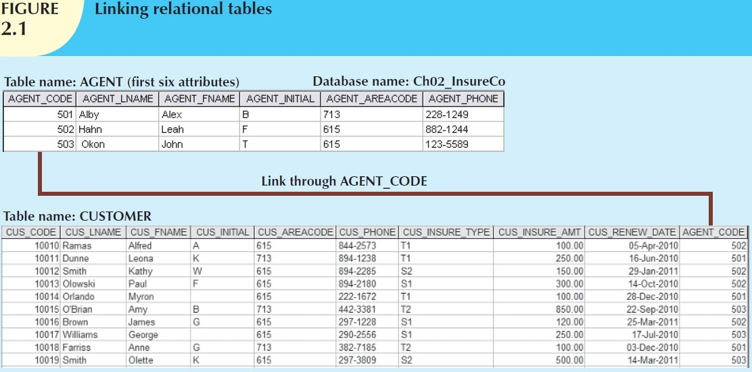
Evolution of Data Models (contd.)
14

Slide 15
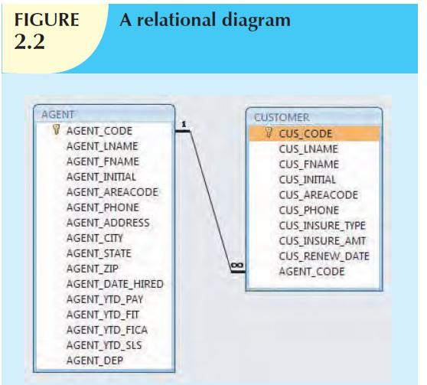
Evolution of Data Models (contd.)
15

Slide 16
Evolution of Data Models (contd.)
16
Entity Relationship Model (ERM)
Widely accepted standard for data modeling
Peter Chen introduced ER data model in 1976
Graphical representation of entities and their relationships in a database structure
Represented in a Entity Relationship Diagram (ERD)
Entity: represented by rectangle, capital letters, singular form, each row called Entity Instance or Entity Occurrence
Relationships: describes association among data (Fig. 2.3)
(Will cover in more detail in coming lectures)

Slide 17
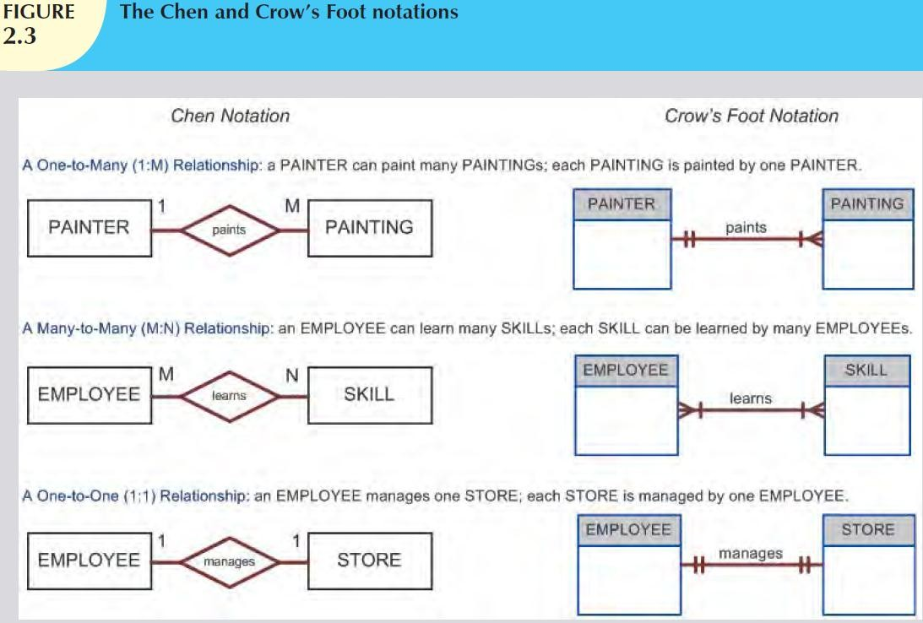
Evolution of Data Models (contd.)
17

Slide 18
Evolution of Data Models (contd.)
18
Object-Oriented Model (OO Model)
Complex real-world problems needed a data model that more
closely represents the real world.
Both data and their relationships are contained in a single structure called object. (Fig. 2.4)
Said to be a semantic data model because semantic indicates
meaning. Based on following components:
Object: one occurrence of an entity
Class: collection of similar objects with shared attributes and methods
Attributes: properties of objects
Method: class procedures representing actions: finding, changing, printing
Class Hierarchy: upside-down tree, each class has one parent. Example: CUSTOMER and EMPLOYEE share a parent PERSON class.
Inheritance: ability of object within class hierarchy to inherit attributes and
methods of the class above.

Slide 19
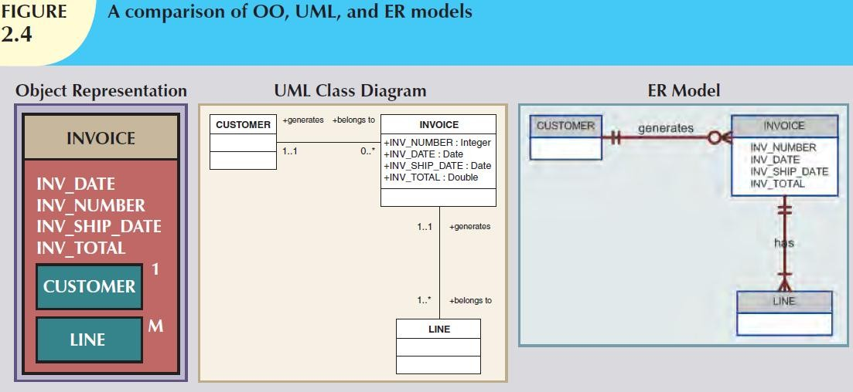
Evolution of Data Models (contd.)
19

Slide 20
Evolution of Data Models (contd.)
20
Newer Data Models: Object/Relational and XML
Demand to support more complex data representations gave
rise to Extended Relational Data Model (ERDM).
ERDM gave birth to a new generation of relational databases supporting OO features.
With emergence of internet as a business communication tool, Extensible Markup Language (XML) emerged as the efficient exchange of structured, semi-structured and unstructured data.
To address the need of managing large amounts of unstructured data such as word-processing documents, Web pages, emails and diagrams, XML databases emerged.
At the same time, O/R DBMSs added support for XML-based documents within their relational data structure.

Slide 21
Conclusion
21
In this Chapter, we…
Introduced what data modeling and data model is
Discussed the importance of data models
Explained the building blocks of a data model
Described what business rules are and listed examples
Covered Evolution of Data Models
Briefly went over several types of data models

